Slide 1
Supply Chain collaboration Game training
Zensimu
Estimated duration: 1h-2h
https://zensimu.com/

Slide 2
Plan
Option 1
Single-Round session – Total: 1h
Supply Chain basics (5 min)
Game introduction (5 min)
Round 1 (30 min)
Debriefing and discussion (20 min)
Option 2
Two-Rounds session – Total: 1h30-2h
Supply Chain basics (5 min)
Game introduction (5 min)
Round 1 (30 min)
Debriefing and discussion (20 min)
Round 2 (20 min)
General debrief and discussion (10 min)
Tips:
If you have time, consider going for Option 2 – reach more learnings by illustrating how more communication and information sharing improves results!
You can modify/adjust the slides to introduce your own projects and initiatives!
The learnings can be applied in other contexts, such as Agile IT, Lean Office, etc.

Slide 3
Supply chain basics

Slide 4
Supply chain basics
Supply chain definition:
The planning, sourcing, manufacturing, distribution, and delivery of products or services from the point of origin (raw materials) to consumption (arrival at the end consumer).
The supply chain includes all internal and external factories, warehouses, transportation services and all the information flows and processes to coordinate the different elements.
Marketing = create more demand
Operations / Supply chain = fulfill the demand

Slide 5
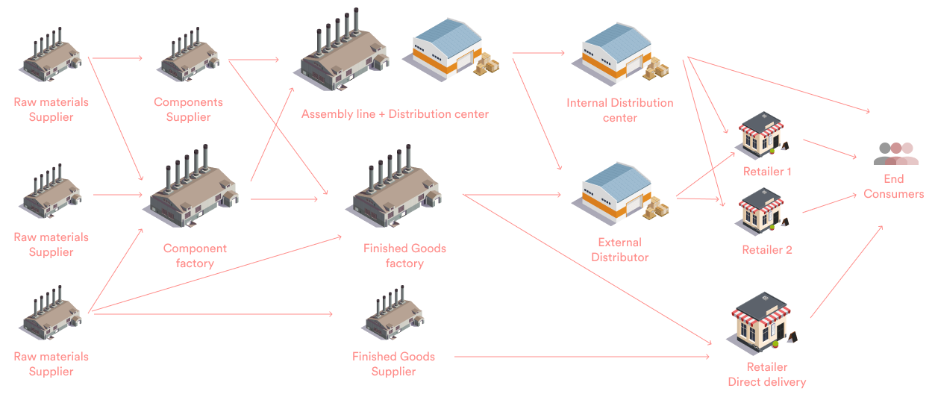
Supply chain basics

Slide 6
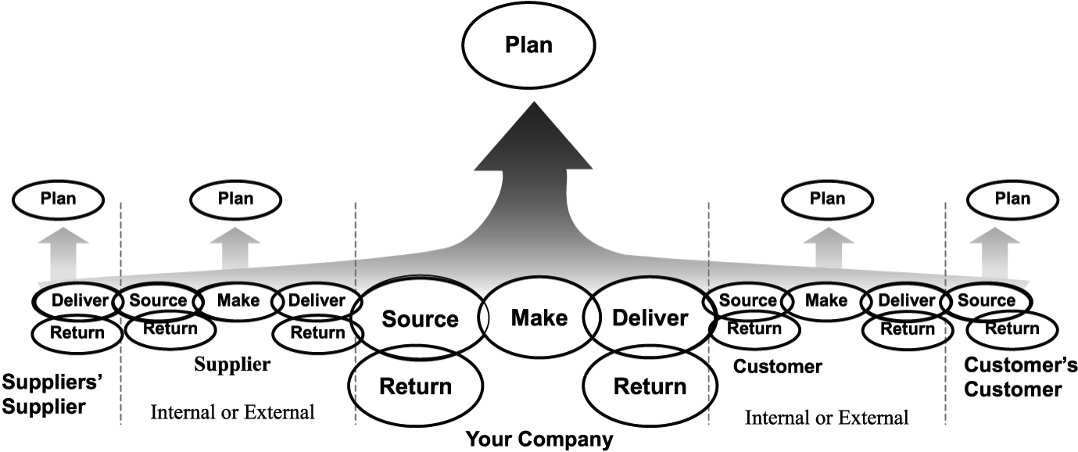
Supply chain basics
The « SCOR » model - Supply Chain Operations Reference :

Slide 7
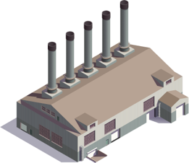
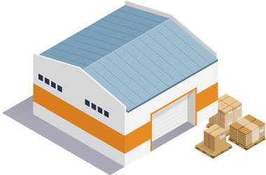
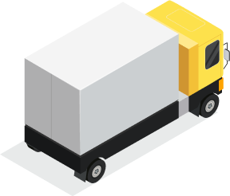
Supply chain basics
Supply Chain Contraints :
Production :
Components availability,
Minimum batch size,
Manufacturing lead time,
Workforce availability,
Machine performance
Storage :
Maximum surface
Shipping/receiving capacity
Transportation :
Delivery lead time
Truck capacity

Slide 8
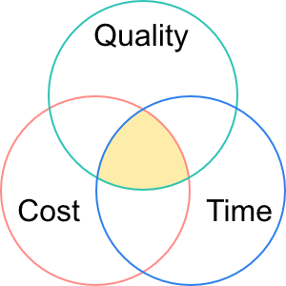
Supply chain basics
Typical Supply chain KPIs:
Service level
Inventory coverage
Inventory turnover
Forecast accuracy
Logistics costs
Customer satisfaction
Lead time
Supply chain Strategy:
Objectives
Trade-offs :

Slide 9
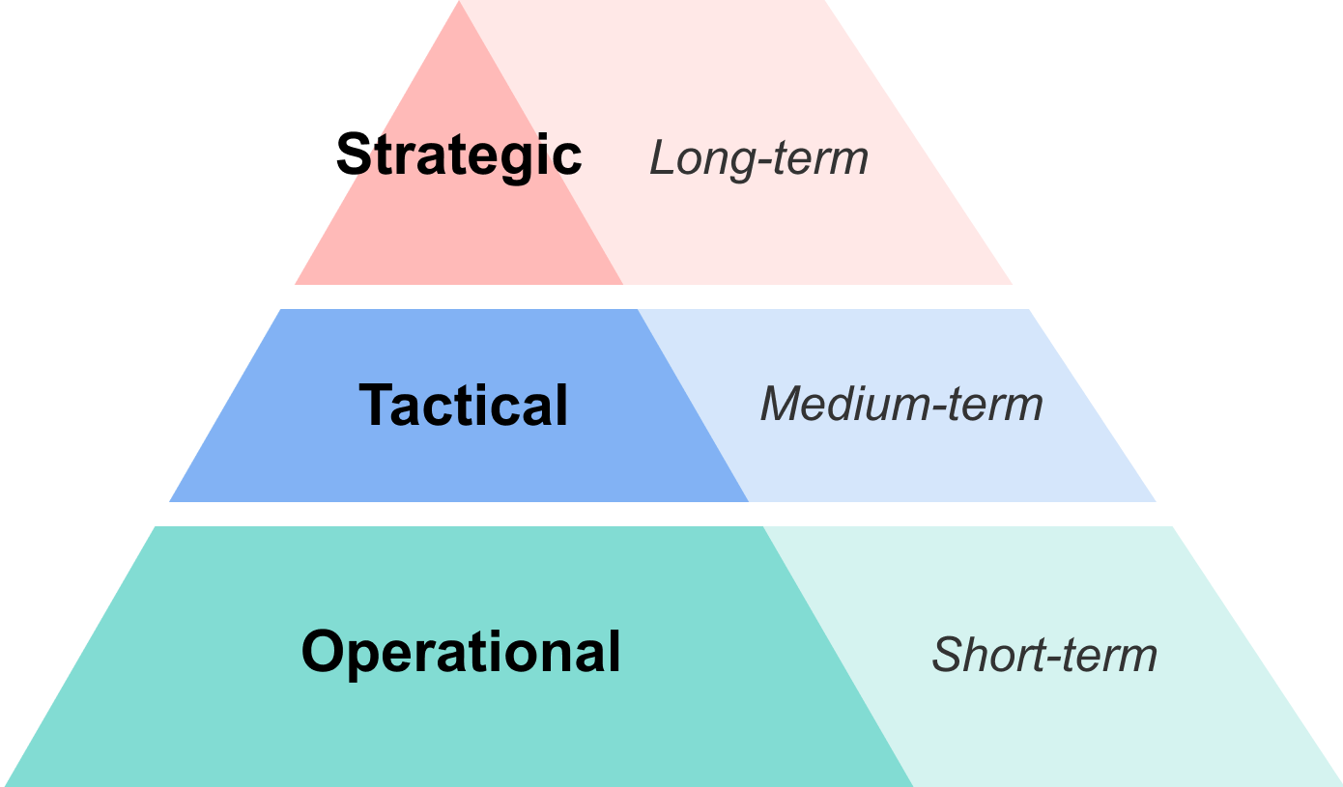
Supply chain basics
Decision levels and horizons:
Decide the type of product /services provided,
Follow-up market trends and innovations,
SC Design decisions (new warehouse/factory)
Supplier selection criterias/strategy
Define processes (manufacturing, transport..),
Outsourcing decision for specific projects,
Performance and Cost analysis,
IT Tools integration, training and best practices
Forecasting, Supply planning,
Production Scheduling, Capacity planning,
Inventory control, Shipping, receiving, transport,
Quality control, returns management

Slide 10
Beer Game introduction
Rules and How to Play

Slide 11


Game Description
What is is:
An online beer simulation game to meet a wide range of objectives — from reproducing real challenges within supply-chain processes to optimising performance through a fun and engaging serious game experience.
What is is not:
A beer drinking game!
SORRY

Slide 12
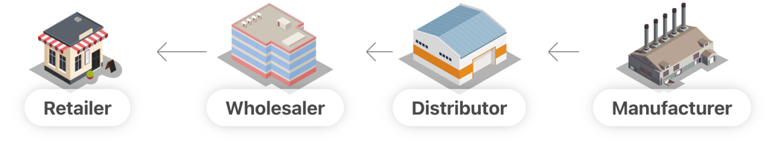
Game Description
The game simulates a Beer supply-chain composed of 4 stages.
You’ll be playing as one of them :
The game is played in several turns (= weeks)

Slide 13
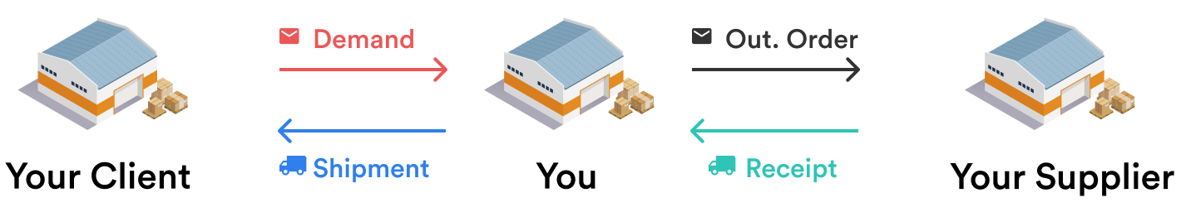
Game Description
Each stage :
Has its own stock of beer cases,
Has a supplier from which it receives beer cases and to which it places orders
The delivery lead time between each stage is 3 weeks
The manufacturer doesn’t have a supplier but produces new beer cases with 3 weeks lead time

Slide 14
Objectives
The game lasts for an unknown number of weeks
Fullfill your client’s demand every week
Costs cumulate every week :
Stock cost : +0.5$ /case/week
Backorder* cost : +1$ /case/week
Try to keep both low stock and low backorders to reduce your costs!
*Backorder = stockouts, late quantities waiting to be fulfilled

Slide 15
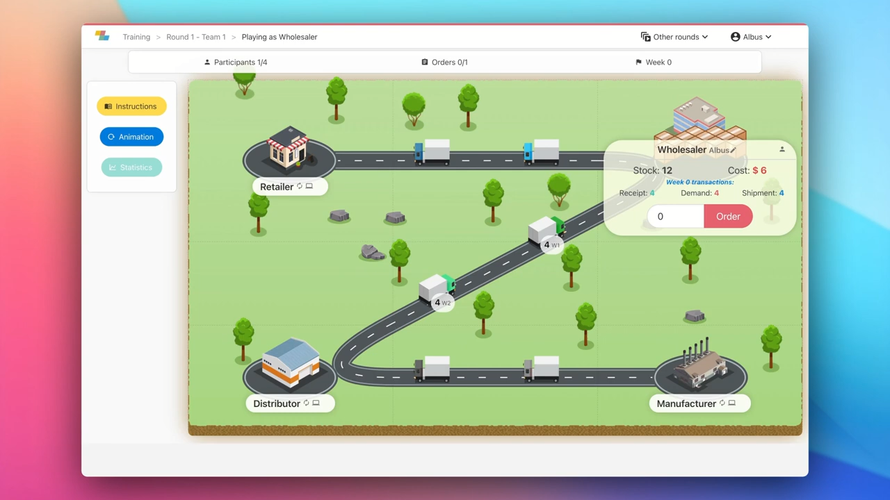

Slide 16
Let’s play! Round 1

Slide 17
Round 1 Debriefing

Slide 18
Global Results
➔ Who is the winning SC ?
What was the main driver of costs ?
Can you see on the graphs when and where ?

Slide 19
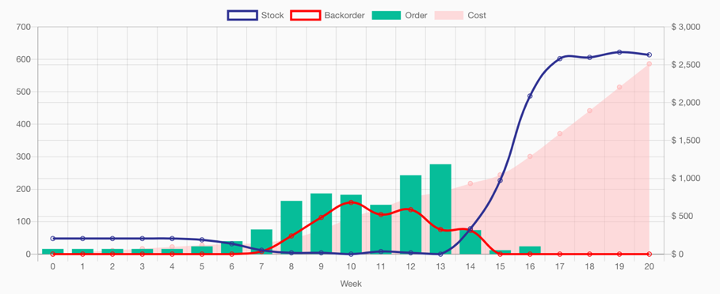
Global Results
High stock
High backorders

Slide 20
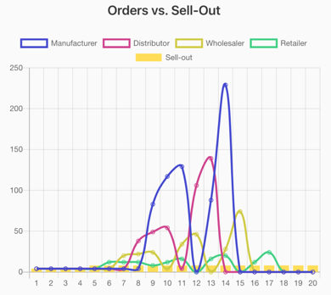
The Bullwhip effect
Orders vs Final Demand :
Question : How do you compare the final demand (“sell-out”) with the Supply Chain orders?

Slide 21
The Bullwhip effect
Orders vs Final Demand :
➔ Answer : Orders fluctuates a lot vs. the real demand. The variations increase as we go upstream to the manufacturer.
No coherence with the actual final demand profile
Sell-out of 4 pcs/week for the first 4 weeks then 8 pcs
(Quite flat)

Slide 22
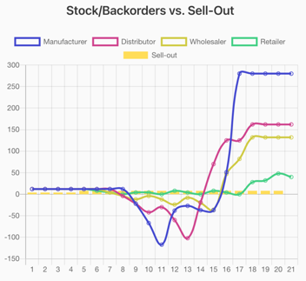
The Bullwhip effect
Stock/Backorders vs Final Demand :
Question : How do you compare the stock profile of the SC stages ?
Answer : Stages alternate between phases of out-of-stock and over-stock at different moments during the game.
This variation increases as we go up the chain to the manufacturer.

Slide 23
The Bullwhip effect

Slide 24
The Bullwhip effect: Discussion
Question :
What led you to order with these high variations ?
Did you have a specific stategy ?

Slide 25
The Bullwhip effect: Discussion
« I didn’t have visibility on the future demand »
« I ordered more to keep a safety stock »
« My supplier wouldn’t deliver so I increased my orders »
« I was afraid I wouldn’t have enough stock »
« I started to have backorders so I increased my orders to be safe »
« My client suddenly increased his orders »
« The Lead Time didn’t allow me to react quickly »
« I tried to optimize my own stock »
« I lost count of how much I had ordered before »

Slide 26
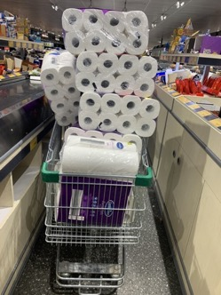
The Bullwhip effect
Example of shortages we can link to a bullwhip effect during the COVID-19 pandemic :
People want to secure stock so buy more than needed
Toilet paper :
Source : Forbes
Playstation 5 :
Source : Games Radar
Face masks :
Source : OECD

Slide 27
The Bullwhip effect: Discussion
Question :
How could we reduce the Bullwhip effect ?

Slide 28
The Bullwhip effect: Discussion
Potential Answers :
Communicate more and build a strategy (information sharing/collaboration)
Re-order only what is needed to keep a minimum stock at each stage, avoid peaks (planning tools/kanban)
Project the future sales to order/plan in advance (demand forecasts)
Reduce the lead times to be able to supply more quickly between both ends of the supply chain (improve performance)
Reduce the number of stages, ship from the manufacturer to the retailer (supply-chain design)

Slide 29
Let’s play! Round 2

Slide 30
Round 2 Description
New rules:
Communication is allowed.
Everyone can see the stock/orders of the other players.
Try to work together to make sure the supply chain delivers:
With no backorders
With reasonable stock
At the end: did the results improve vs. Round 1 ?

Slide 31
Round 2 Debriefing
Did the results improve vs. Round 1?
Why do you think the results improved?
Did you employ a specific strategy in Round 2?
How could you have improved your results even more?

Slide 32
Examples of collaboration
The communication and information-sharing typically allows players to use some of the below strategies:
All players can see the final demand at the retailer, and discuss/anticipate the future.
➔ This corresponds to the « demand » side of a S&OP meeting
Players avoid ordering more than what their suppliers can ship, but if needed ask them if they can increase their supply plan.
➔ Corresponds to the « supply » side of a S&OP meeting
Players can decide where to keep safety stock, and then create a « pull » process by all ordering the same amount, avoiding « spikes » in the middle.
Players can share information about the future promotions and anticipate these increases by bulding safety stock in an « orderly » manner (without creating backorders)

Slide 33
General debriefing: Improving supply chains

Slide 34
Improving supply chains
Planning Tool 1 : S&OP
Planning process :
All functions should discuss :
Financial objectives/information
Marketing plans
Production capacity
Objective : build a common plan shared by everyone
« Sales and operations planning (S&OP) is an integrated business management process through which the executive/leadership team continually achieves focus, alignment and synchronization among all functions of the organization »
Also communicate with:
Suppliers: when demand inflates
Customers: about their actual needs – avoid « inflated » forecasts

Slide 35
Improving supply chains
Planning Tool 2 : MRP
MRP is like a big calculator. Based on several supply parameters, it determines all the reorders quantities necessary at each stage.
➔ Often used together with forecasts and a S&OP collaborative planning process
In the Game:
The retailer estimates future demand (forecast). Then determines the amounts he will order to the Wholesaler in the future – based on his safety stock, already incoming quantity etc.
From this information, and using his own supply parameters, the Wholesaler decides how much it will need for the future weeks, and communicate this information to the Distributor.
The Distributor and then the Manufacturer do the same.
Demand-Driven MRP :
More advanced planning calculation, using dynamic buffers and strategic inventory to reduce the bullwhip and improve performance

Slide 36
Improving supply chains
Planning Tool 3 : Forecasting software
Allows several teams (marketing, sales, finance) to collaborate on the forecasts
Calculate demand using algorithms and statistical models
Work on aggregate information such as product family/category,
Work on various units: value (€, $), quantity, years, months..
Data visualization for reporting and analysis

Slide 37
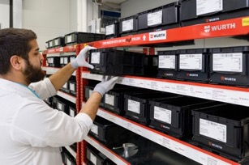
Improving supply chains
Planning Tool 4 : Kanban and « pull » systems
Especially useful for components or spare parts products, used at scale in the automotive industry

Slide 38
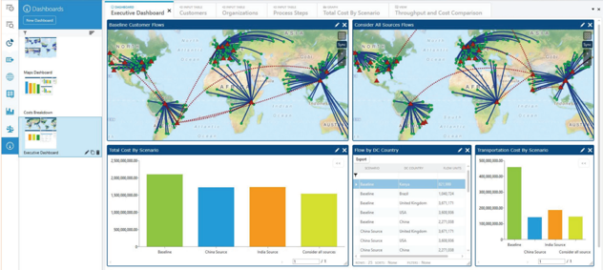
Improving supply chains
Supply-Chain network design: ex: « Llamasoft » software
Map the flows
Create « What-if » scenarios
Identify waste in inventory/transportation
Objective: make the supply-chain more reactive and resilient
In the game:
Reducing the lead time
Reducing the number of stages

Slide 39
Improving supply chains
Sustainability and CSR (Corporate Social Responsibility)
Reduce all types of waste (moving/producing too much..)
Calculate greenhouse gas emissions and define objectives to reduce them
Audit the impacts throughout the whole lifecycle : from product design to production, distribution and end-of-life
Require suppliers to follow ethical, social and environmental standards
Source locally and shorten supply chain length

Slide 40
Merci / Thanks!
Mathias Le Scaon
mathias@zensimu.com
https://zensimu.com/

